Slide 1
Data Analysis Python Project
By: Aditya Jayasur

Slide 2
Analyzing Occupation Data Set in Finance & Insurance, and Real Estate, Rental & Leasing
https://datausa.io/profile/naics/finance-insurance-and-real-estate-rental-leasing#growth
Notes:
Data Set that i picked along with link

Slide 3
Why pick this data set?
Real Estate, Rental & Leasing is the #1 Largest Industry in the country(13% of total GDP)
Finance and Insurance is the 3rd largest Industry(8% of total GDP)
Offices/Companies reopening across the nation as we near the hopeful end of the pandemic
Notes:
Some reasons why I picked this data set.

Slide 4
The Question:
As the country reopens, should changes be made to the structure of these sectors based on total population and average wage in the years prior to the pandemic?
Notes:
Which so many huge changes made over the past year seemed like a valuable question to ask if working for a company that was in this field. Definitely something to consider to create a better structure for the corporation.

Slide 5
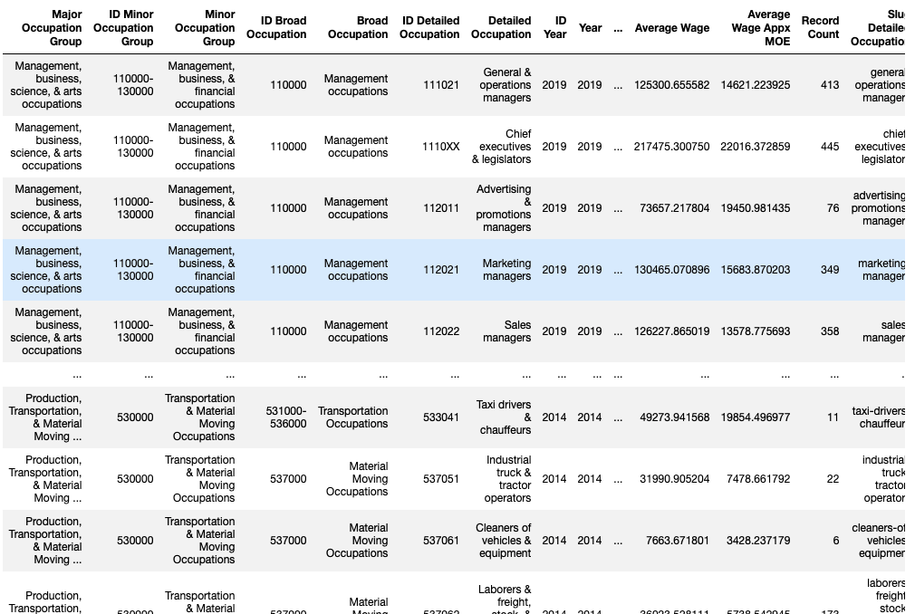
The data
Notes:
Columns: Major Occupation Group, Minor Occupation Group, Broad Occupation, Detailed Occupation, Year, Average Wage, Average Wage Margin of Error
1234 Rows x 24 Columns
Broad Occupation value count: 21
Detailed Occupation value count: 301

Slide 6
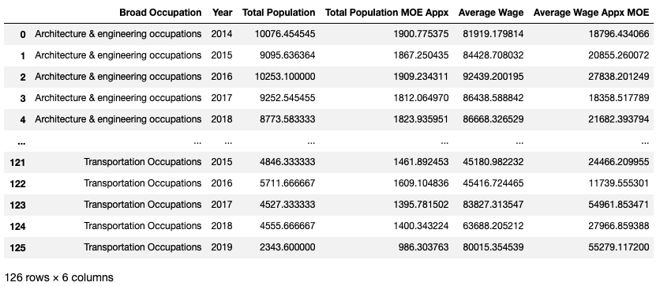
(Cleaned) Data
Notes:
Grouped by Broad Occupation and got the average for total population and average wage for each year

Slide 7
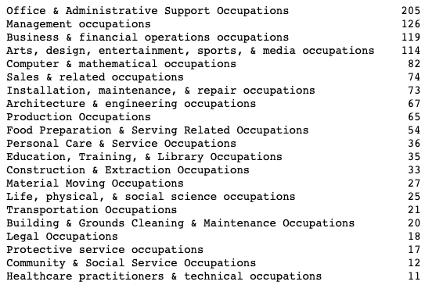
Broad Occupation
Notes:
Office and Administrative Support had the most positions. This is not to say it is the most populated occupation.

Slide 8
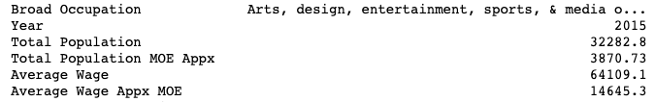
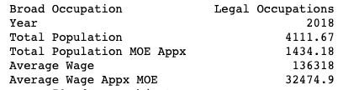
Max avg
Notes:
Arts, design entertainment, sports and media in 2015 with total population avg of 32,282 and avg wage mean of 64,109(3rd most positions)
Legal with avg wage mean of 136,318 and population mean of 4111(4th Least positions)

Slide 9
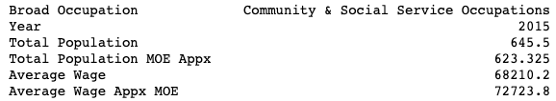
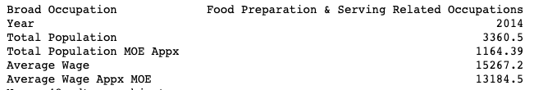
Min avg
Notes:
Community & Social Service pop: 645 wage:68,210(2nd Least Positions)
Food Preperation & Serving Related wage:15,267 pop: 3360

Slide 10
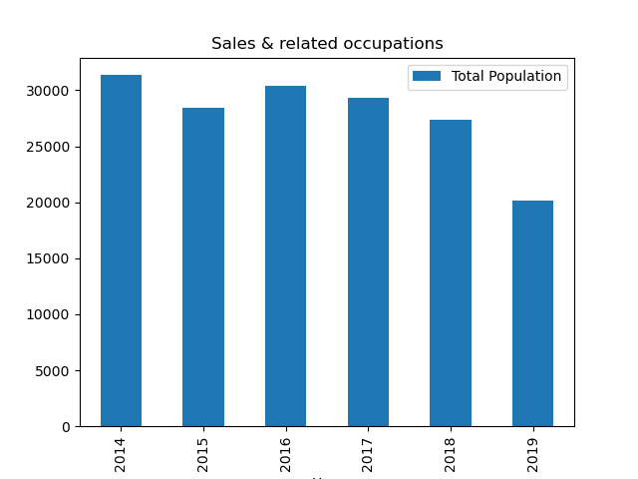
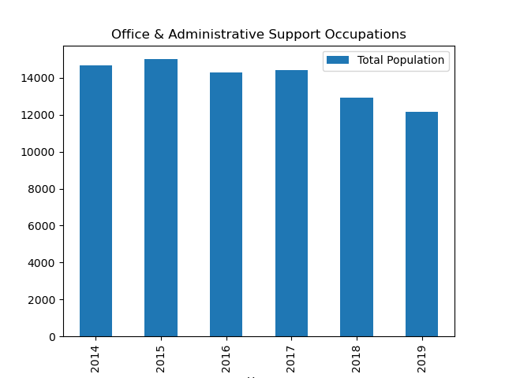
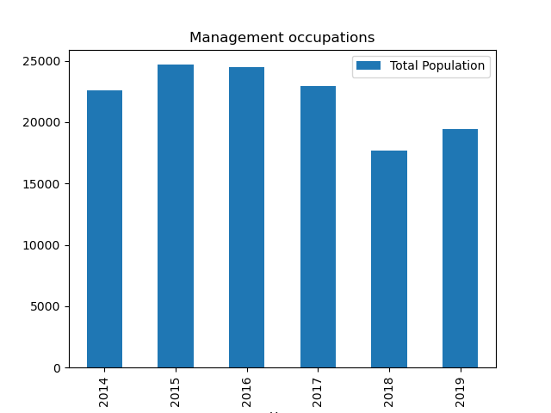
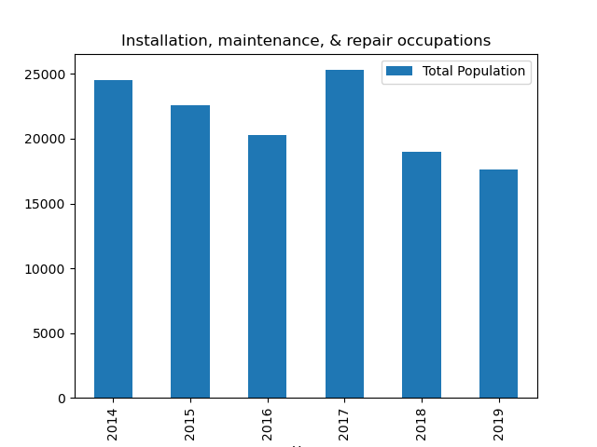
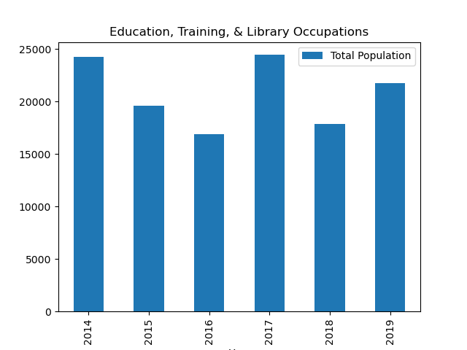
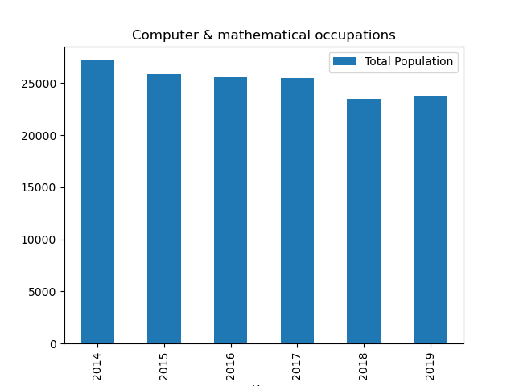
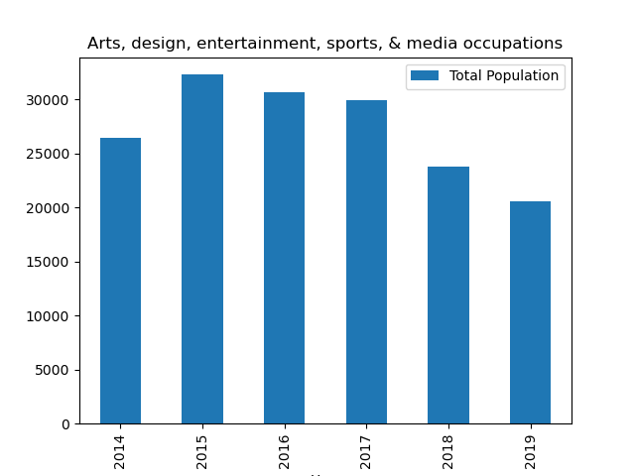
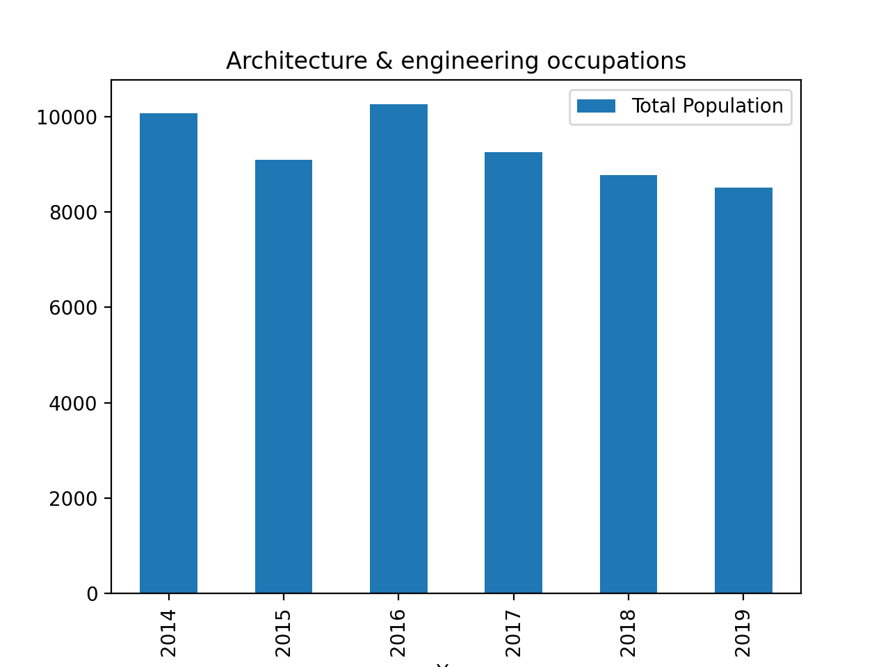
Max Pop charts
Notes:
Trend of population avg decreasing among larger charts, consider watching to see how valuable these positions are in the future

Slide 11
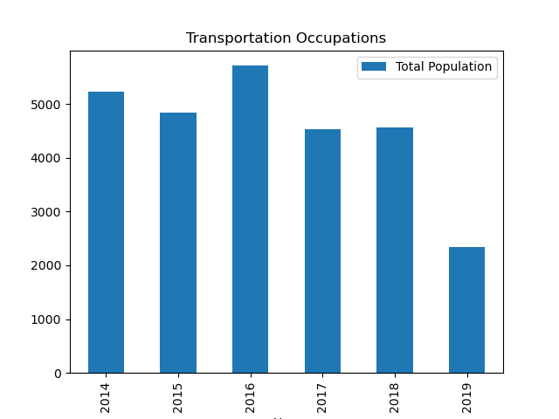
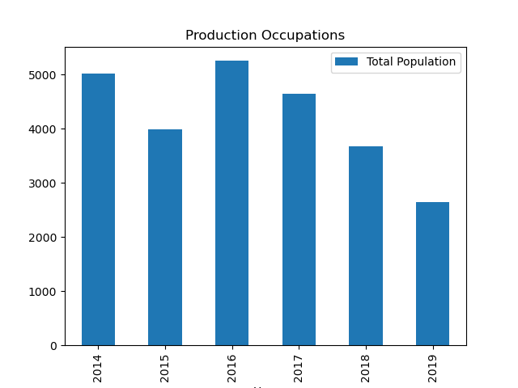
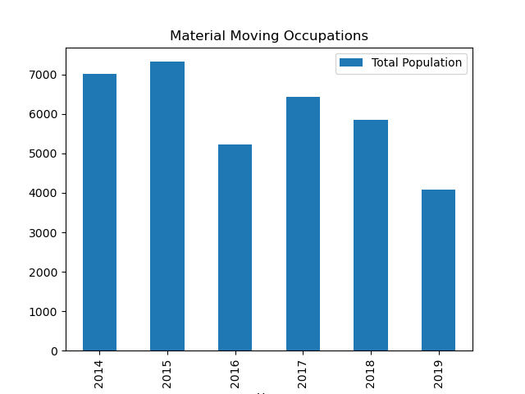
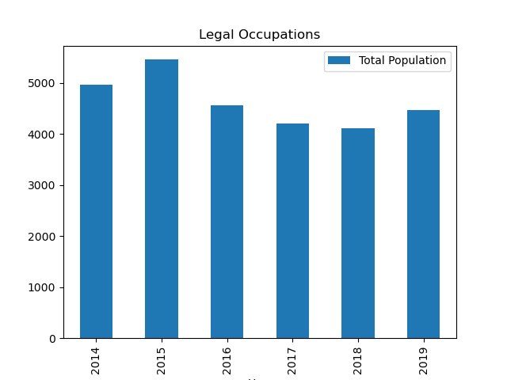
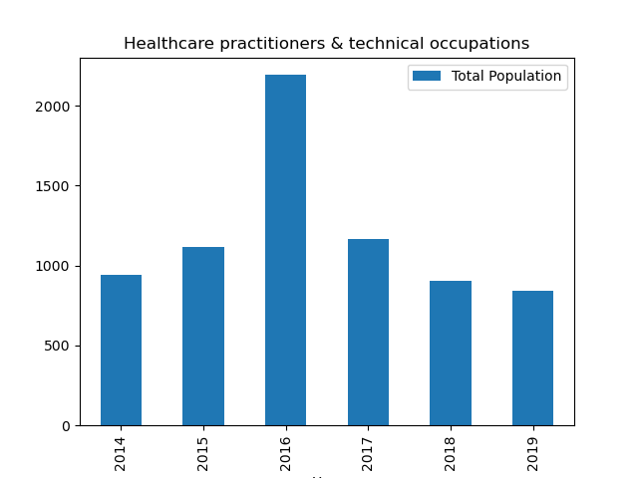
Min Pop Chart
Notes:
Charts that caught my eye as they are the lowest pop but still decreasing. Healthcare chart seems like an outlier that may require additional data to make proper analysis from

Slide 12
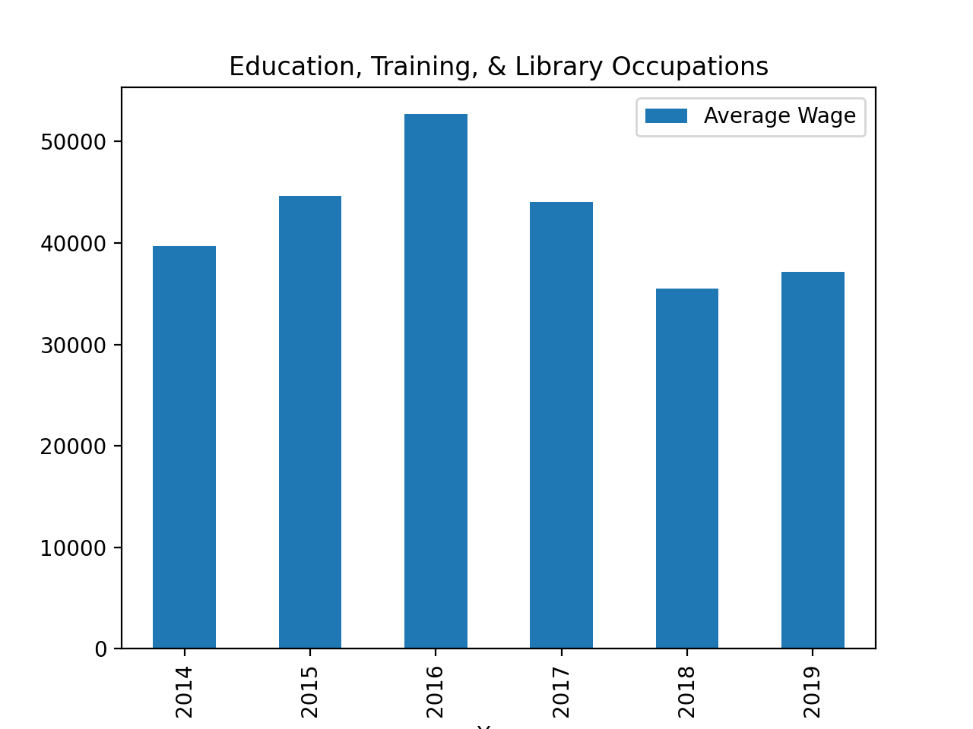
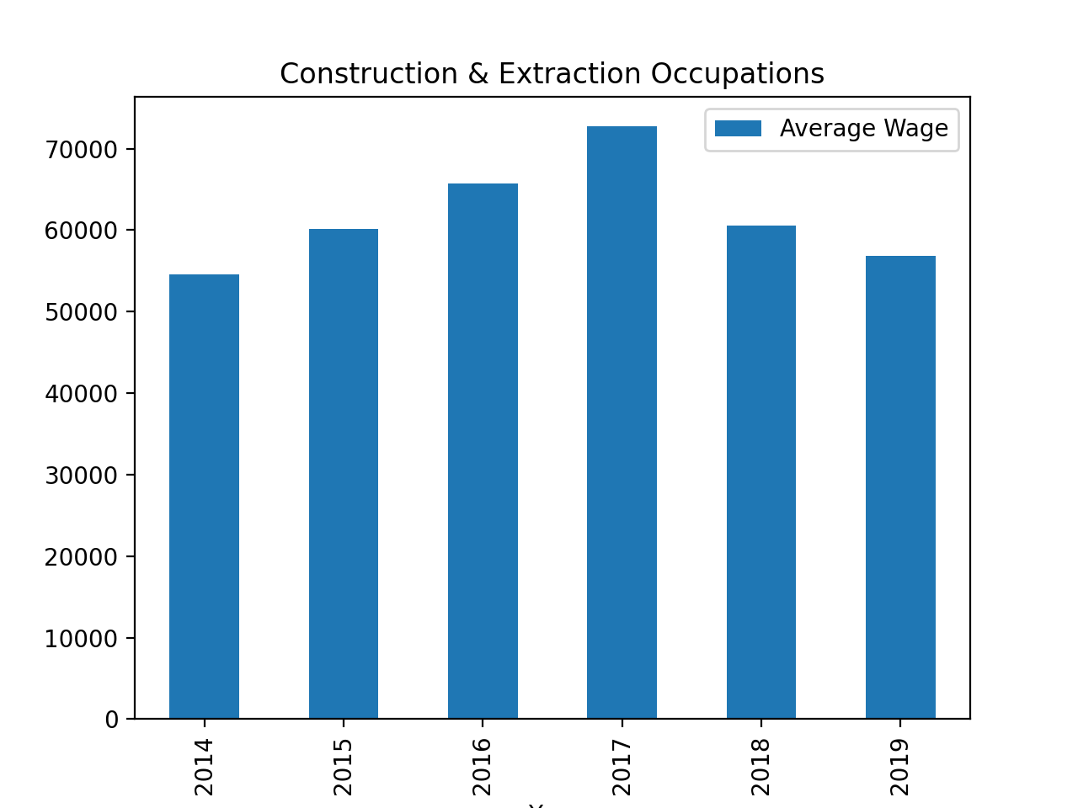
Avg wage decline
Notes:
Of all the wage charts, only two with declination over years

Slide 13
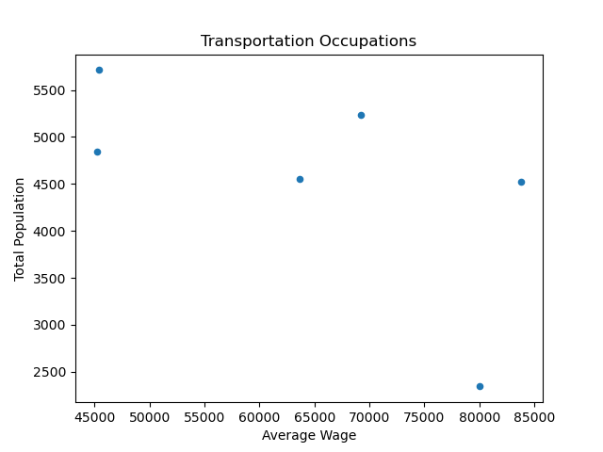
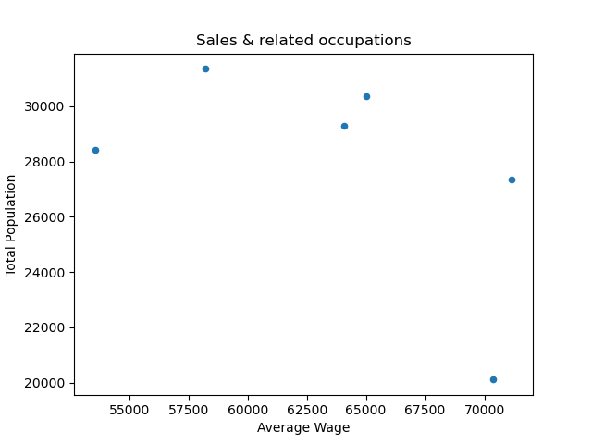
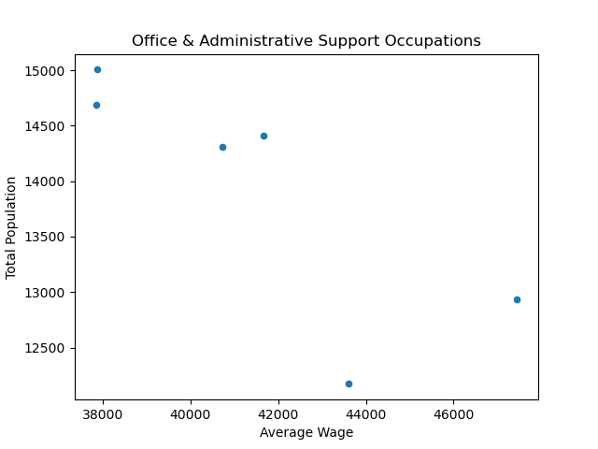
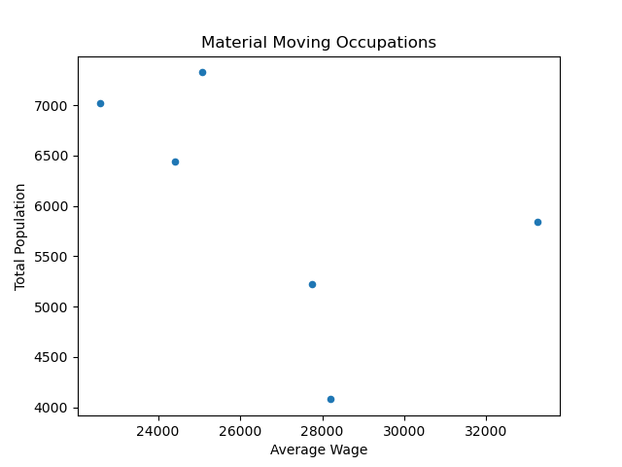
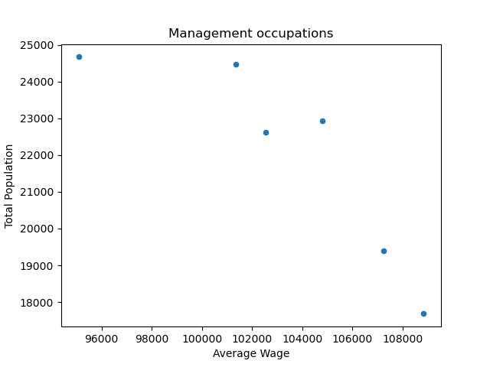
pop/wage scatter
Notes:
Examples of what all the scatter plots look like, as wage rise, pop decreases

Slide 14
Conclusion
A definite answer can’t be produced with the given information(eg. Healthcare data)
Occupations with larger populations seem to be declining and vice versa for smaller populations
Consider restructuring the larger and smaller populated occupations to meet the trending demand
Some of the smaller populated occupations are still declining and might not be as heavily required
Notes:
With the info provided its hard to make a decision but what can be done is put considerations on the table that can be monitored in the coming months to figure out what changes can be made. These are some of the things I would consider keeping on the table.

Slide 15
If given more time
FInd more data to understand most recent trends and compare to existing data set
Split the data so the two sectors can be analyzed separately
Look deeper into the data by analyzing through Detailed Occupations
Notes:
With time being one of the biggest drawback there are a couple things I would do if allowed more time.

